Slide 1
MONISHA R
821721243038
B-TECH ARTIFICIAL INTELLIGENCE AND DATA SCIENCE 3RD YEAR
SIR ISSAC NEWTON COLLEGE OF ENGINEERING AND TECHNOLOGY

Slide 2
DOCUMENT CLASSIFICATION USING CONVOLUTIONAL NEURAL NETWORK (CNN)

Slide 3


AGENDA
The agenda of document classification using convolutional neural network (CNN) provides a structured approach to guide the document classification project from data preprocessing to model deployment and beyond. Adjustments can be made based on specific project requirements and constraints.Distribution of document types or categories.
Problem Statement
Project overview
Who Are The End Users
Your Solution And Its Value Proposition
The Wow In Your Solution
Modeling
Result
The process techniques such as TF-IDF, word embeddings, and deep learning models are often employed to build effective document classification systems.
3/21/2024 Annual Review

Slide 4

PROBLEM STATEMENT
In the document classification of convolutional neural network (CNN) context of an organization dealing with a large volume of unstructured text documents, the task is to develop an automated document classification system to efficiently categorize incoming documents into predefined classes. The goal is to streamline document management processes, improve information retrieval, and facilitate decision-making.
Challenges include handling noisy and unstructured text data, addressing class imbalance issues, and ensuring scalability and performance in handling large datasets. Additionally, the system should provide interpretable results to aid in understanding the classification decisions and allow for easy integration into existing workflows.

Slide 5

PROJECT OVERVIEW
The project aims to develop a document classification system utilizing Convolutional Neural Networks (CNNs) to automatically categorize text documents into predefined classes or categories. CNNs have demonstrated effectiveness in capturing hierarchical patterns in data, making them suitable for sequential data like text.
By leveraging CNNs for document classification, the project aims to develop an efficient and accurate system capable of handling large volumes of text documents across diverse categories. The implementation of CNNs allows for the extraction of meaningful features from text data, enabling effective categorization and organization of documents for improved information retrieval and decision-making processes.

Slide 6
WHO ARE THE END USERS?
The end users of a document classification system using CNNs can vary depending on the specific application and context of the project. Here are some potential end users for such a system:
Corporate Organizations
Government Agencies
Educational Institutions
Legal Firms
Healthcare Providers
Media and Publishing Industry
Information Retrieval Platforms
Companies or platforms providing information services, such as news aggregators, content management systems, or search engines, may utilize document classification systems to categorize and recommend relevant content to users. End users could include content curators, editors, or end consumers accessing the platform.

Slide 7

YOUR SOLUTION AND ITS VALUE PROPOSITION
The document classification solution employing Convolutional Neural Networks (CNNs) presents a transformative approach to managing textual data, offering a robust value proposition across various domains. By harnessing CNNs' prowess in pattern recognition and hierarchical feature extraction, our solution optimizes document management workflows with unparalleled efficiency and accuracy. This means streamlined processes, reduced manual effort, and minimized errors in document classification tasks.
In essence, our CNN-based document classification solution stands as a beacon of innovation, poised to revolutionize how organizations leverage textual data to drive informed decisions, gain competitive advantages, and unlock new opportunities in today's data-centric landscape.

Slide 8

THE WOW IN YOUR SOLUTION
Our cutting-edge document classification solution, powered by Convolutional Neural Networks (CNNs), delivers a resounding "wow" factor across industries and domains. Imagine seamlessly organizing vast troves of textual data with unprecedented efficiency and accuracy. With CNNs at the helm, our solution revolutionizes document management, automating tedious classification tasks and significantly reducing manual labor. But that's not all – our solution scales effortlessly to tackle even the most colossal document collections, ensuring no text goes uncategorized.
Prepare to be wowed as our CNN-powered document classification solution propels your organization into a future where insights are at your fingertips, decisions are data-driven, and possibilities are limitless.
3/21/2024 Annual Review

Slide 9
MODELLING
In the context of document classification using CNNs, "modeling" refers to the process of designing and building the Convolutional Neural Network architecture. This includes determining the number and types of layers, the size of filters, the activation functions, and other architectural decisions. The goal is to construct a CNN model that can effectively learn features from document representations and make accurate predictions about the class labels of the documents.
This process involves experimentation, fine-tuning, and validation to achieve the best possible performance on the task of document classification.
Convert textual documents into numerical representations that can be fed into the CNN. This typically involves techniques like word embedding (e.g., Word2Vec, GloVe) to represent words as dense vectors, or character-level embeddings for handling out-of-vocabulary words.

Slide 10
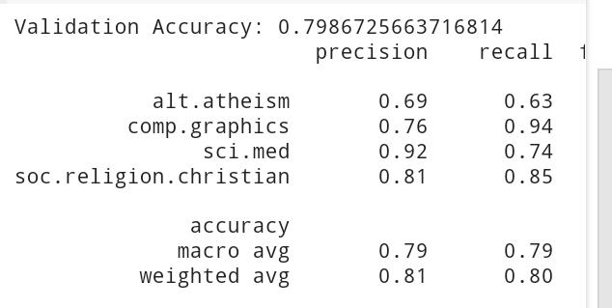
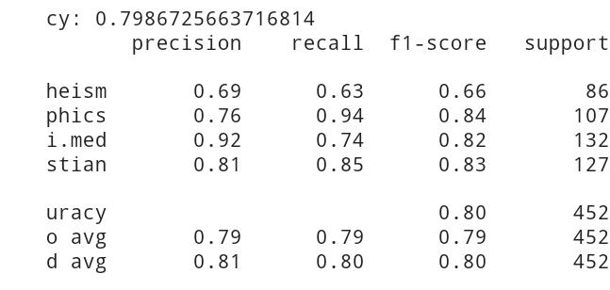
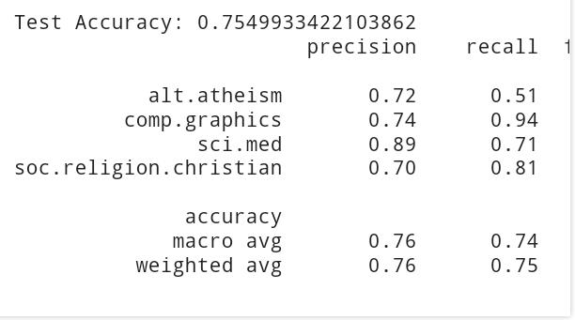
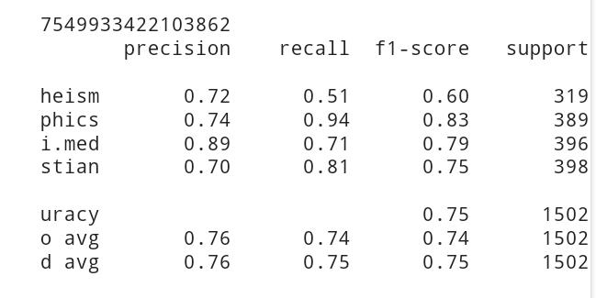
RESULTS
Validation Accuracy :
Test Accuracy :
n

